Slide 1
Impact Analysis Report – Learning Outcomes (Baseline vs Midline)
Assessment of Student Performance | 2026

Slide 2
Executive Summary
The Treatment group showed stronger learning gains (+27.1%) compared to Control (+14.1%), despite starting from a lower baseline.
The intervention generated an additional impact of +13.1 percentage points beyond the progress observed in the Control group.
Subject-wise analysis shows the strongest additional gain in Numeracy, with meaningful improvement also visible in Reading and Writing.
Grade-wise and school-wise comparisons indicate that improvement is visible across multiple levels of the system.
The intervention had the strongest impact among lower-performing students, showing clear value for foundational learning improvement.

Slide 3
Objective of the Analysis
Evaluate change in student learning outcomes between Baseline and Midline
Compare performance across Reading, Writing, and Numeracy
Assess impact of intervention (Treatment vs Control groups)
Identify which segment of students benefited the most
Provide actionable insights for program improvement

Slide 4
Dataset Overview
Total Students (Baseline): 375
Total Students (Midline): 300
Control (Baseline): n = 228
Treatment (Baseline): n = 147
Control (Midline): n = 169
Treatment (Midline): n = 131
Schools Covered: 8
Grades Included: Grades 2–5 for grade-wise comparison slides, since your new charts are explicitly filtered to Grades 2–5.
Insight:
The analysis covers 8 schools across Control and Treatment groups, with separate baseline and midline cohorts. Grade-wise and school-wise comparisons are presented for Grades 2–5 to ensure cleaner and more reliable group-level interpretation.

Slide 5
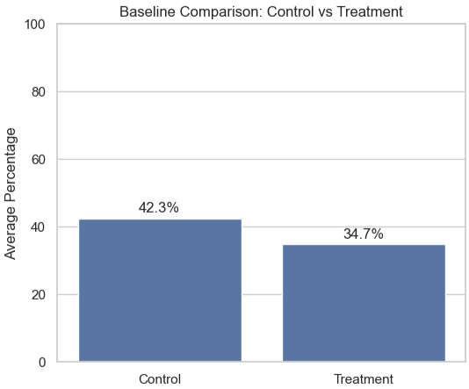
Starting Point: Baseline Comparison
Control: 42.3%
Treatment: 34.7%
Insight:
At baseline, the Treatment group started 7.6 percentage points below the Control group, indicating a weaker initial learning position before the intervention. This provides an important starting reference for assessing later improvement.

Slide 6
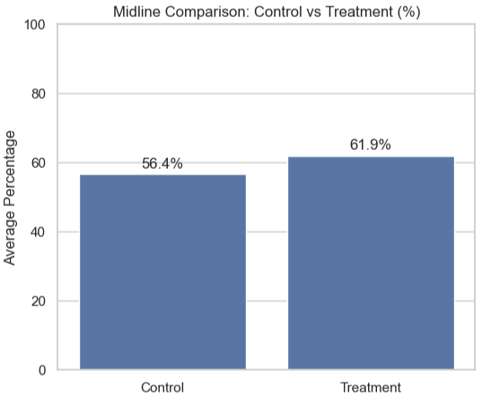
End Point: Midline Comparison
Control: 56.4%
Treatment: 61.9%
Insight:
By midline, the Treatment group had moved 5.5 percentage points ahead of the Control group. This reversal from a weaker starting position to stronger endline performance suggests meaningful learning progress under the intervention.

Slide 7
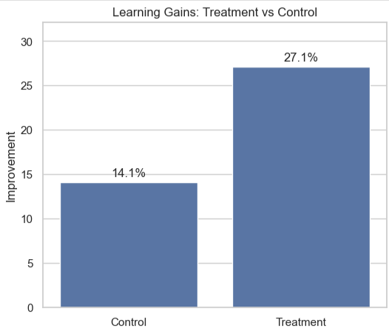
Learning Gains: Treatment vs Control
Control improvement: +14.1%
Treatment improvement: +27.1%
Insight :
The Treatment group achieved nearly double the improvement compared to the Control group.
This indicates that the intervention had a clear and measurable impact on accelerating student learning outcomes.

Slide 8
Impact of Intervention (Difference-in-Differences)
Control Improvement: +14.1%
Treatment Improvement: +27.2%
Additional Impact (DiD): +13.1%
Insight:
The Treatment group improved 13.1 percentage points more than the Control group, indicating a strong additional impact of the intervention beyond natural learning progress.

Slide 9
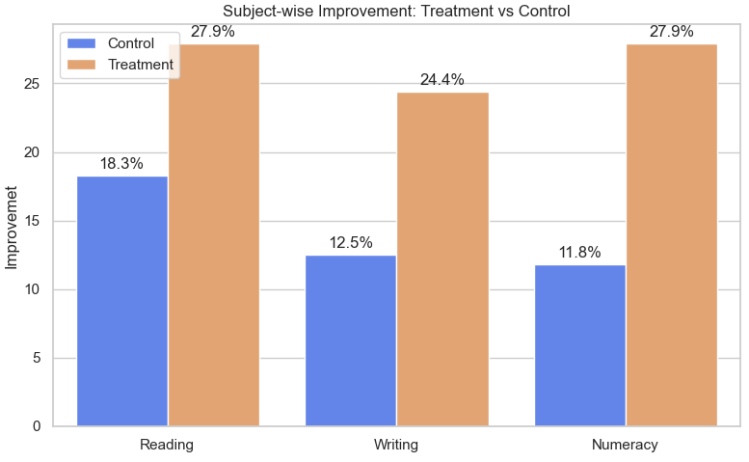
Subject-wise Improvement: Treatment vs Control
Reading: Control 18.3% | Treatment 27.9% Writing: Control 12.5% | Treatment 24.4% Numeracy: Control 11.8% | Treatment 27.9%
Insight:
The Treatment group outperformed the Control group across all three subjects, showing that the intervention had broad academic impact rather than improving only one area. The largest additional gain is seen in Numeracy, indicating the strongest intervention effect in quantitative learning.

Slide 10
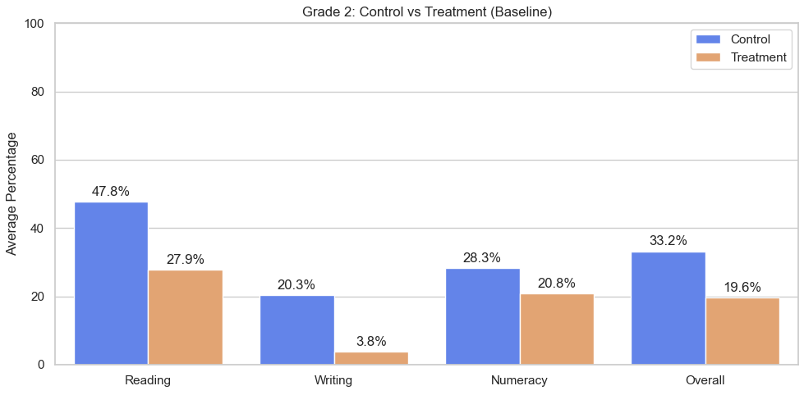
Grade 2: Control vs Treatment (Baseline)
Control (Overall): 33.3%
Treatment (Overall): 19.6%
Insight:
In Grade 2, the Treatment group begins from a weaker or mixed baseline position relative to Control, especially in foundational domains. This makes later improvement in this grade important for assessing early intervention effectiveness.

Slide 11
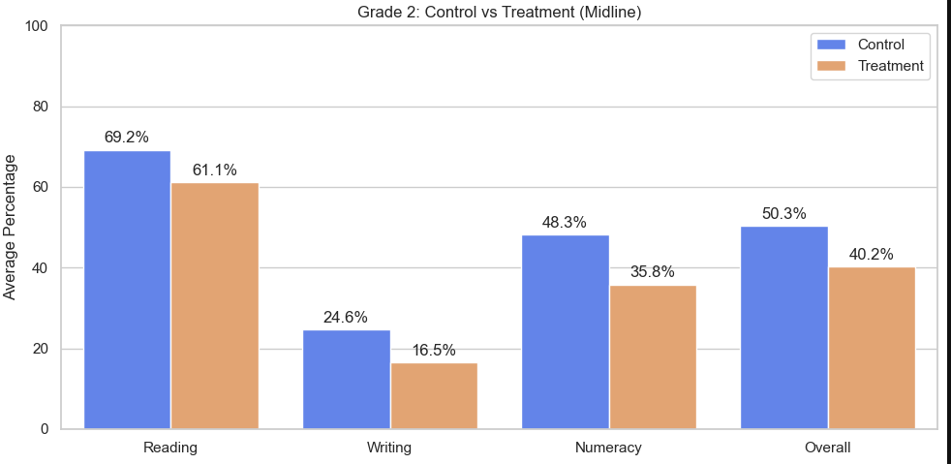
Grade 2: Control vs Treatment (Midline)
Control (Overall): 50.3%
Treatment (Overall): 40.2%
Insight:
By midline, Grade 2 students in the Treatment group show stronger subject-wise performance, suggesting that the intervention is contributing to foundational gains at an early stage of schooling. Improvement at this grade level is particularly important because it supports later learning readiness.

Slide 12
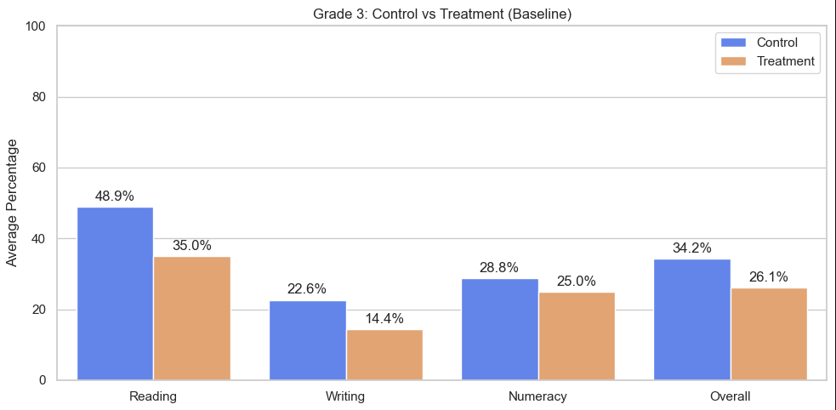
Grade 3: Control vs Treatment (Baseline)
Control (Overall): 34.2%
Treatment (Overall): 26.1%
Insight:
Grade 3 baseline results show that the Treatment group did not begin with a performance advantage, reinforcing that later gains should be interpreted as meaningful progress rather than a continuation of stronger starting scores.

Slide 13
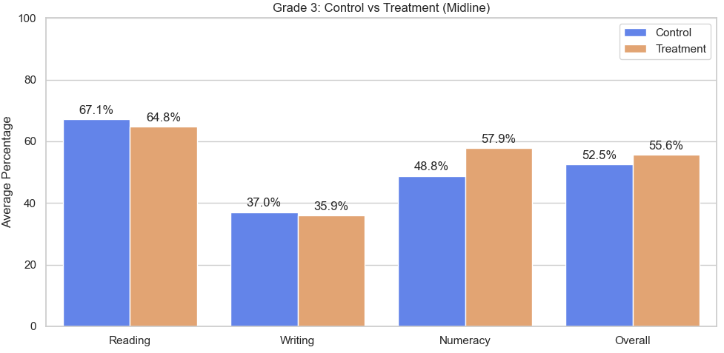
Grade 3: Control vs Treatment (Midline)
Control (Overall): 52.5%
Treatment (Overall): 55.6%
Insight:
At midline, Grade 3 Treatment students demonstrate stronger outcomes across subjects, indicating that the intervention is supporting measurable improvement beyond the baseline gap. This suggests good momentum in the middle primary grades.

Slide 14
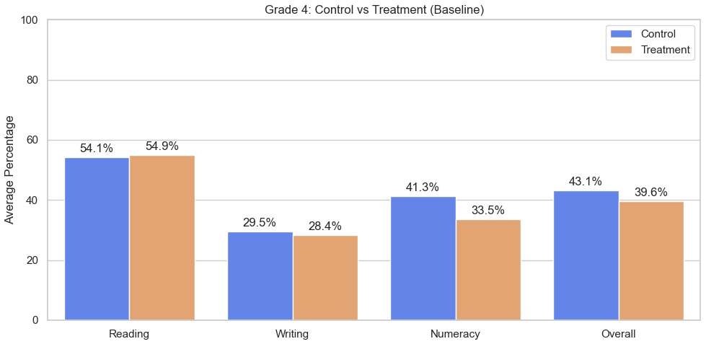
Grade 4: Control vs Treatment (Baseline)
Control (Overall): 43.1%
Treatment (Overall): 39.6%
Insight:
Grade 4 baseline performance remains uneven across subjects, but the Treatment group generally starts from a weaker or comparable level rather than an advantage. This strengthens the interpretation of later gains as intervention-driven progress.

Slide 15
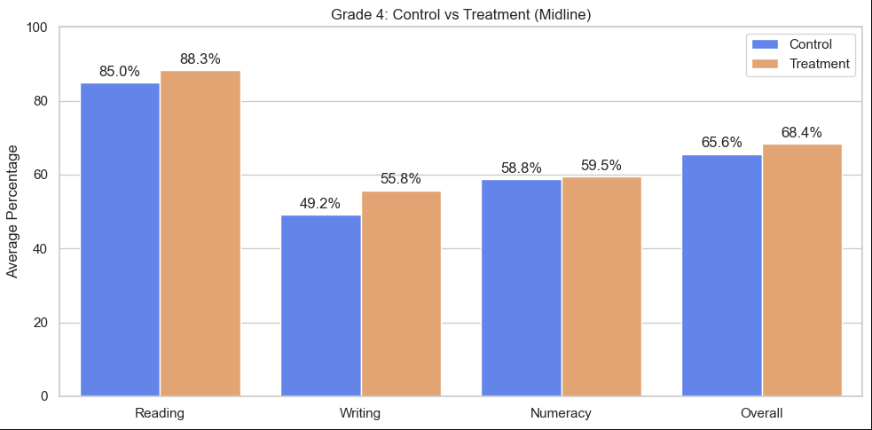
Grade 4: Control vs Treatment (Midline)
Control (Overall): 65.6%
Treatment (Overall): 68.4%
Insight:
By midline, Grade 4 Treatment students show stronger subject-wise performance, especially where the intervention appears to have improved both literacy and numeracy outcomes. This indicates that impact is not limited to early grades only.

Slide 16
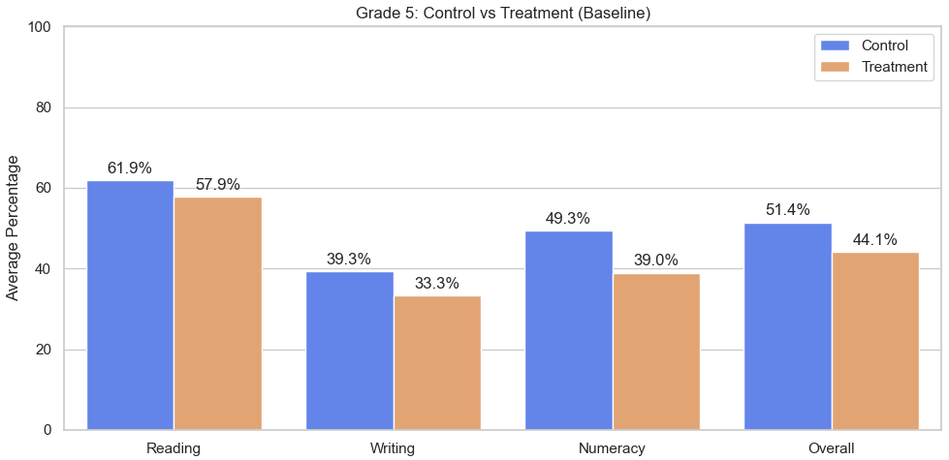
Grade 5: Control vs Treatment (Baseline)
Control (Overall): 51.4%
Treatment (Overall): 44.1%
Insight:
At baseline, Grade 5 results show subject-level variation between groups, but the Treatment cohort does not begin with a clear academic advantage. This makes later Treatment gains more meaningful at the upper-primary level.

Slide 17
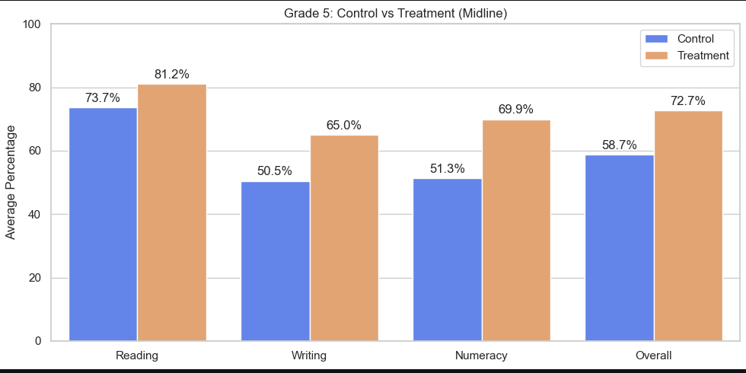
Grade 5: Control vs Treatment (Midline)
Control (Overall): 58.7%
Treatment (Overall): 72.7%
Insight:
By midline, Grade 5 Treatment students remain competitive or stronger across subjects, suggesting that the intervention continues to support learning progress even at higher grade levels where academic expectations are more demanding.

Slide 18
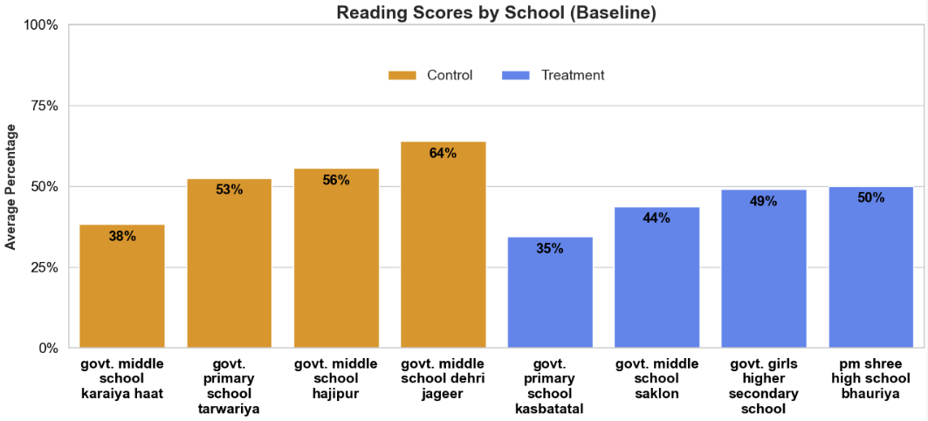
Reading Scores by School (Baseline)
Insight:
Baseline Reading performance varies substantially across schools, showing that students did not start from a uniform literacy level. This variation highlights why school-wise comparison is important for understanding where the intervention had the most room to create impact.

Slide 19
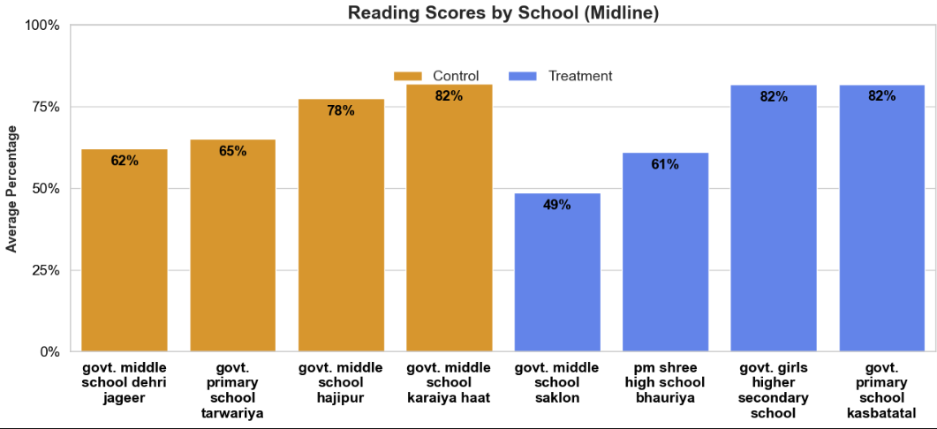
Reading Scores by School (Midline)
Insight:
By midline, Reading performance improves across several schools, with stronger gains visible in Treatment-supported schools. This suggests that the intervention contributed to school-level progress in foundational literacy.

Slide 20
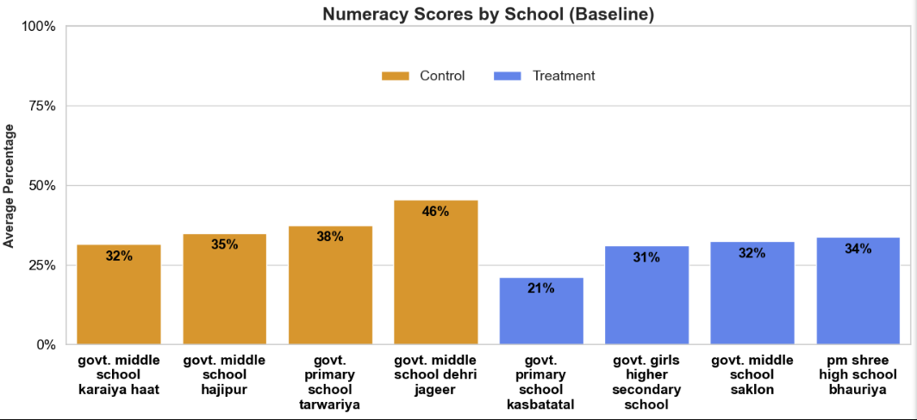
Numeracy Scores by School (Baseline)
Insight:
Baseline Numeracy scores are more uneven across schools, indicating that quantitative learning was already a challenge area before the intervention began. This makes Numeracy an important domain for judging school-level improvement.

Slide 21
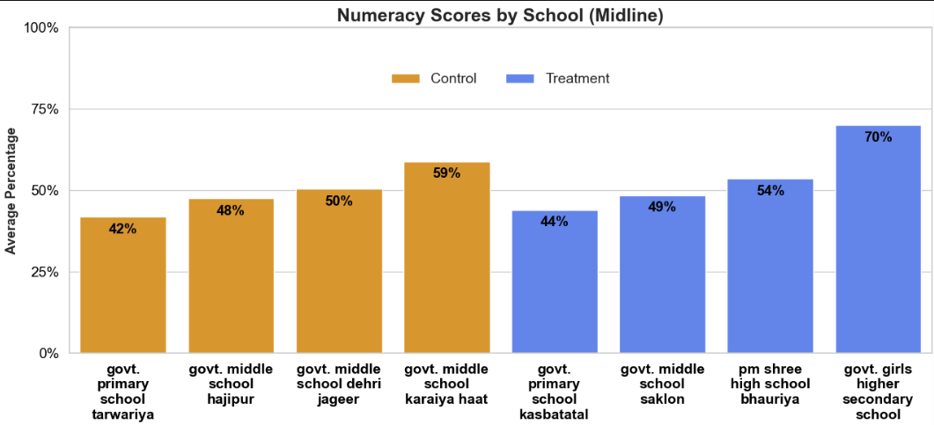
Numeracy Scores by School (Midline)
Insight:
Midline Numeracy performance shows stronger gains across schools, especially where Treatment support is present. This reinforces the broader finding that Numeracy is one of the strongest areas of intervention impact.

Slide 22
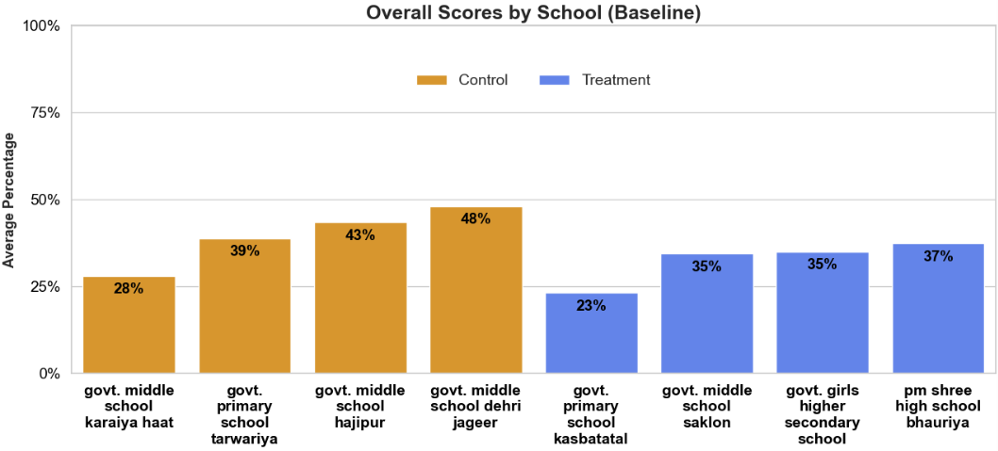
Overall Scores by School (Baseline)
Insight:
At baseline, overall school performance differs noticeably, showing variation in starting readiness across the eight schools. These differences make school-wise tracking essential for understanding intervention effectiveness more accurately.

Slide 23
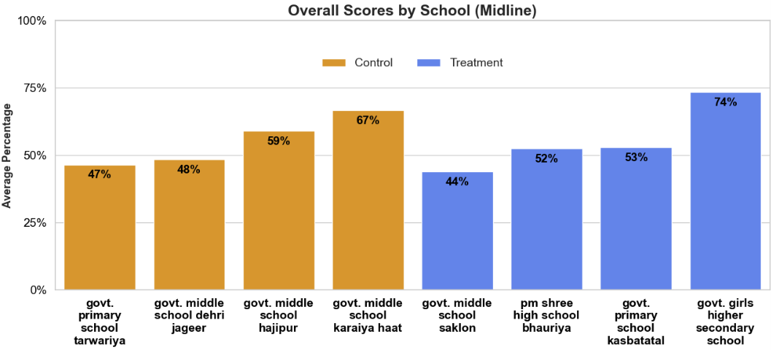
Overall Scores by School (Midline)
Insight:
By midline, several schools show stronger overall performance, indicating that improvement is visible not just at the aggregate group level but also at the school level. This supports the scalability of the intervention across multiple school contexts.

Slide 24
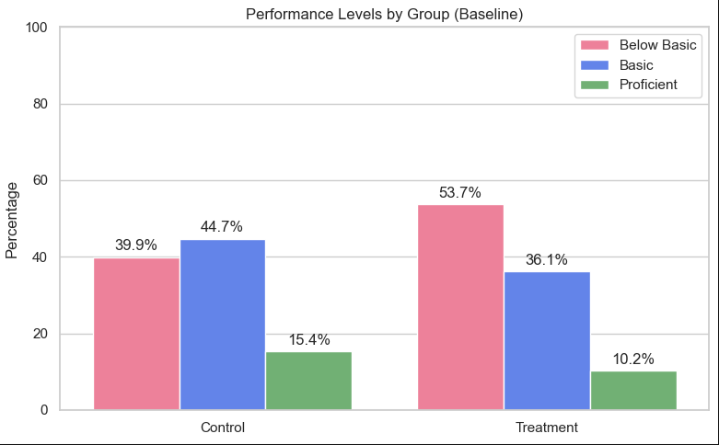
Performance Levels by Group (Baseline)
Below Basic: 0% – 33%
Basic: 34% – 66%
Proficient: 67% – 100%
Insight:
At baseline, the Treatment group had a larger concentration of students in the Below Basic category and a smaller share in Proficient compared to Control. This confirms that the intervention group started from a weaker learning base.

Slide 25
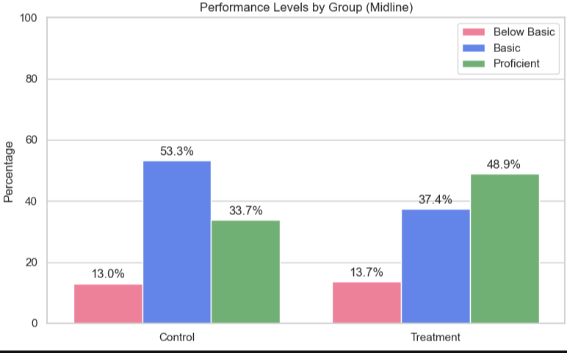
Performance Levels by Group (Midline)
Below Basic: 0% – 33%
Basic: 34% – 66%
Proficient: 67% – 100%
Insight:
By midline, the Treatment group shows a stronger movement into the Basic and Proficient categories, indicating improvement not just in average scores but also in the overall distribution of student performance levels.

Slide 26
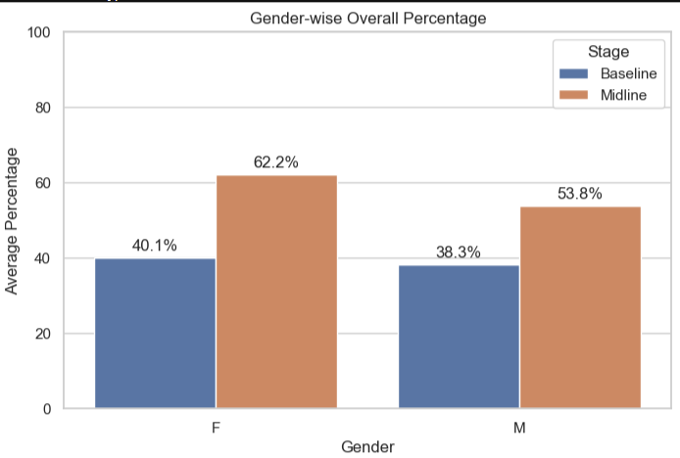
Gender-wise Performance Analysis
Female (Baseline): 40.1% → 62.2%
Male (Baseline): 38.3% → 53.8%
Insights:
Both male and female students showed strong improvement.
Female students demonstrated slightly higher performance and gains; however, overall improvement is consistent across genders, indicating that the intervention is broadly effective.

Slide 27
Strength of Overall Improvement
Effect Size (Cohen’s d): 0.92
Key Insight:
The improvement from baseline to midline is not only statistically significant but also practically strong.
An effect size of 0.92 indicates a large and meaningful shift in student performance, demonstrating that the observed gains are substantial and impactful at the population level.

Slide 28
T-Test (Baseline vs Midline)
T-statistic: 11.998
P-value: < 0.001
Key Insight:
The difference between baseline and midline performance is highly statistically significant, confirming that the observed improvement is extremely unlikely to be due to chance.

Slide 29
T-Test (Control vs Treatment)
T-statistic: 2.29
P-value: 0.023
Key Insight:
There is a statistically significant difference between Control and Treatment groups at midline, with the Treatment group performing better overall.

Slide 30
Chi-Square Test (Distribution)
Chi-square: 13.00
P-value: 0.0015
Key Insight:
The distribution of students across performance levels differs significantly between Control and Treatment groups, indicating a meaningful shift in learning outcomes beyond average score differences.

Slide 31
Correlation Insight(Midline)
Reading vs Writing: 0.61
Writing vs Numeracy: 0.58
Reading vs Numeracy: 0.52
(All relationships statistically significant, p < 0.001)
Key Insight:
A strong relationship exists between Reading and Writing, indicating that literacy skills develop together.
• Moderate to strong relationships are observed between literacy and numeracy, suggesting that students performing well in one domain tend to perform well in others.
• The highest correlation between Reading and Writing highlights the importance of strengthening foundational literacy skills.
• Overall, student performance shows consistency across subjects, reflecting interconnected learning abilities.

Slide 32
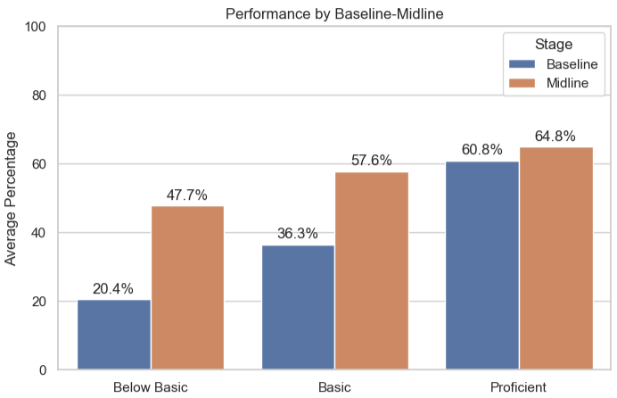
Who Benefited the Most?
Below Basic: +27.3% improvement
Basic: +21.3% improvement
Proficient: +4.0% improvement
Insight:
Students who started in the Below Basic category showed the highest improvement (+27.3%), followed by Basic learners (+21.3%), while gains among Proficient students were significantly lower (+4.0%).
This indicates that the intervention was most effective for lower-performing students, helping them achieve substantial learning gains.

Slide 33
Key Takeaways
The Treatment group showed substantially stronger learning gains than the Control group despite starting from a weaker baseline
The Treatment group outperformed the Control group by midline despite starting from a weaker baseline position.
The intervention generated an additional impact of +13.1 percentage points beyond natural progress seen in the Control group.
Treatment students showed stronger subject-wise gains across Reading, Writing, and Numeracy, with the largest additional impact in Numeracy.
Grade-wise and school-wise comparisons show that improvement is visible across multiple levels, not only in aggregate averages.
The strongest gains were observed among lower-performing students, indicating that the intervention is especially effective for foundational learning support.
Statistical evidence supports these findings, showing that the observed gains are meaningful and unlikely to be due to chance.

Slide 34
Recommendations
Continue and strengthen the current intervention model, as it has demonstrated stronger gains than the comparison group.
Prioritize Numeracy and Reading as high-impact areas while giving additional attention to Writing, where performance still has room to improve.
Provide targeted support to students in the Below Basic category, as they show the highest responsiveness to intervention.
Review lower-performing schools and grades more closely to identify where implementation support may need to be strengthened.
Use school-wise and grade-wise tracking regularly to monitor whether improvements are consistent across locations and cohorts.
Maintain strong student-level and school-level data quality to support more accurate future impact measurement.
Consider scaling the intervention more broadly, while preserving the components that appear most strongly associated with improvement.

Slide 35
Conclusion
The analysis demonstrates a strong and statistically validated improvement in student learning outcomes. Despite starting from a weaker baseline, the Treatment group improved more rapidly and surpassed the Control group by midline. The intervention shows the strongest impact on foundational learners and delivers meaningful gains across subjects, grades, and schools. Overall, the results indicate that the program is impactful, scalable, and capable of driving measurable learning improvement at scale.

